Slide 1
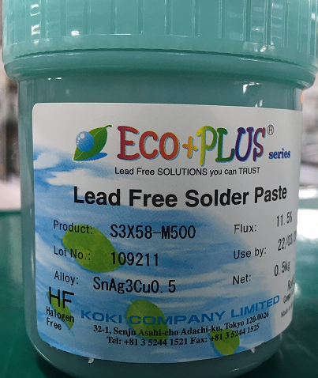
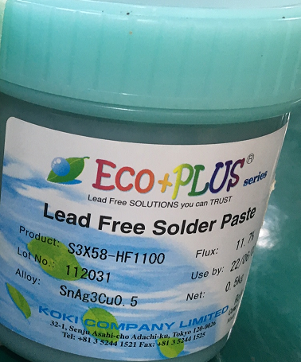
96.1516T00- MIC SMT Solder and Stencil change Control run Report
I. Description:
- On 12/28 SMT Control run change Solder Type and Stencil for verify improvement void solder of MIC parts:
Control run new solder paste S3X58-HF1100 apply for 96.1516T00. This material part number is sample from RD request vendor send to factory.
Change new Stencil with new design improve Solder hole at MIC location, change thickness of Stencil (from 0.1 mm to 0.09 mm.
STT | Specifications | S3X58-M500 | S3X58-HF1100
1 | Composition (%) | Sn96.5Ag3.0Cu0.5 | 96.5Sn 3.0Ag 0.5Cu
2 | Melting point (°C) | 217 － 219 | 217 - 219
3 | Shape | Spherical | Spherical
4 | Particle size (μm) | 20 – 38 | 20 - 38
5 | Halide content (%) | 0 | 0
6 | Flux type*2 | ROL0 | ROL0
7 | Flux content (%) | 11.5 ± 0.5 | 11.7±1.0
8 | Viscosity*1 (Pa.S) | 220 ± 30 | 190±30
9 | Copper plate corrosion*3 | Passed | Passed
10 | Tack time | > 48 hours | ≥ 72 hours
11 | Shelf life (below 10°C) | 6 months | 6 months
12 | Optional powder (μm) | 20 – 45; Product code S3X48-M500 | N/A
S3X58-M500
S3X58-HF1100
Summary: SMT make Control Run follow progress normal at F16 factory.
Verify new solder paste S3X58-HF1100 and make new stencil to improve MIC issue.

Slide 2
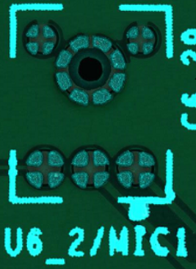
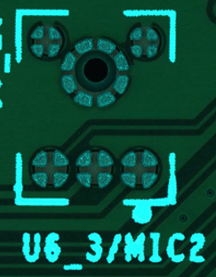
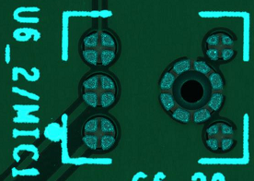
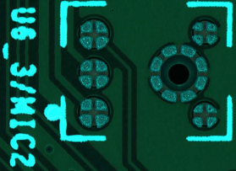
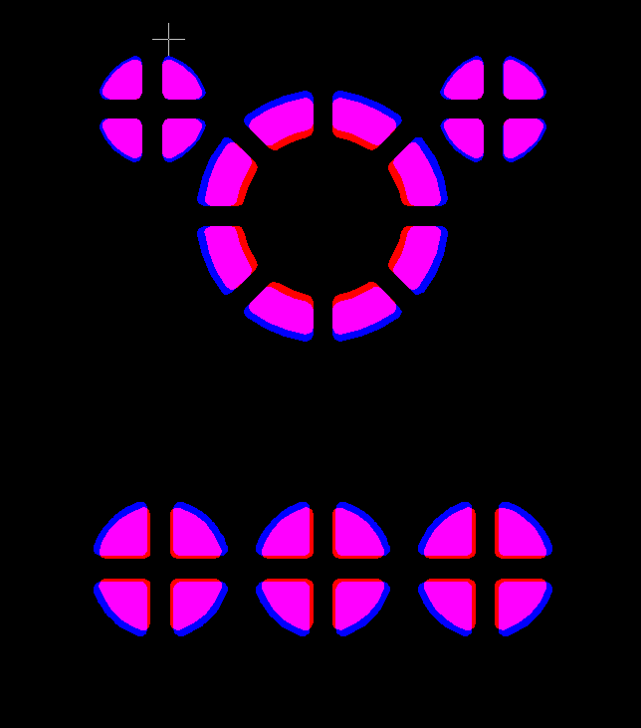
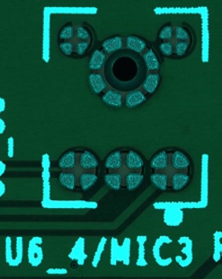
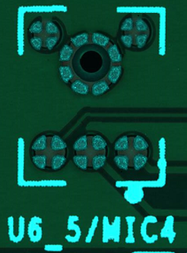
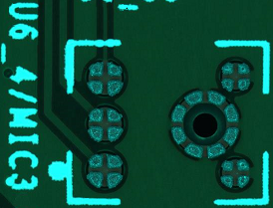
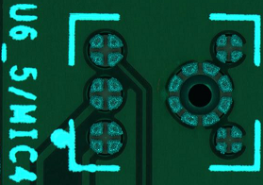
96.1516T00- MIC SMT Solder and Stencil change Controlrun Report
II. Detail Control run:
- On 12/28 SMT Control run change Solder Type and Stencil for verify improvement void solder of MIC parts:
New stencil–0.09 mm
Old Stencil
New Stencil
Summary: SMT make Control Run follow progress normal at F16 factory.
Verify of Stencil have thickness 0.09 mm.

Slide 3
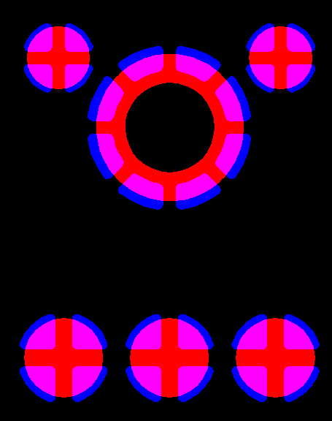
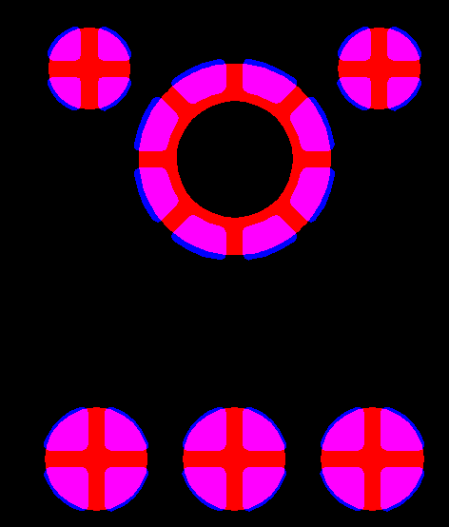
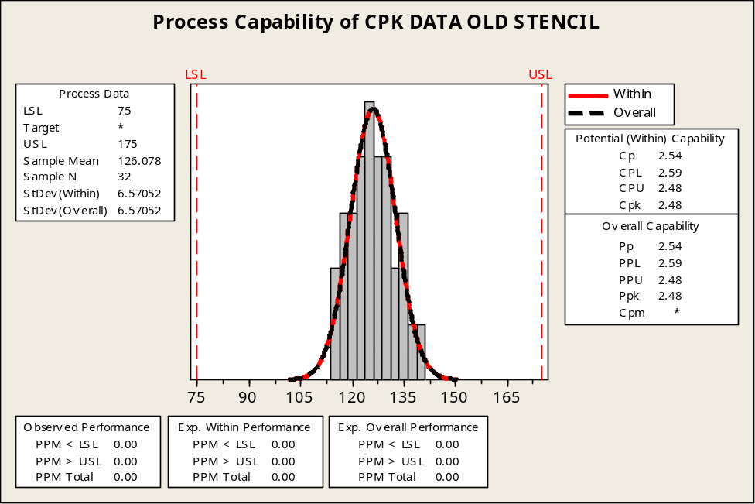
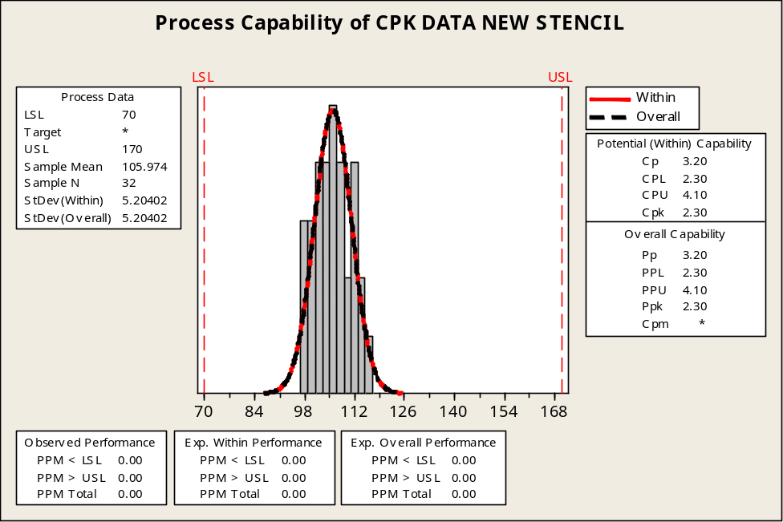
96.1516T00- MIC SMT Solder and Stencil change Control run Report
II. Detail Control run:
75%
69%
76%
70%
Stencil Aperture rate
About:75%~76%
76%
Stencil Aperture rate
About:69%~70%
70%
Old Stencil
New Stencil
Summary: SMT run Control Run follow progress normal at F16 factory.
New Stencil have thickness 0.09 mm.

Slide 4
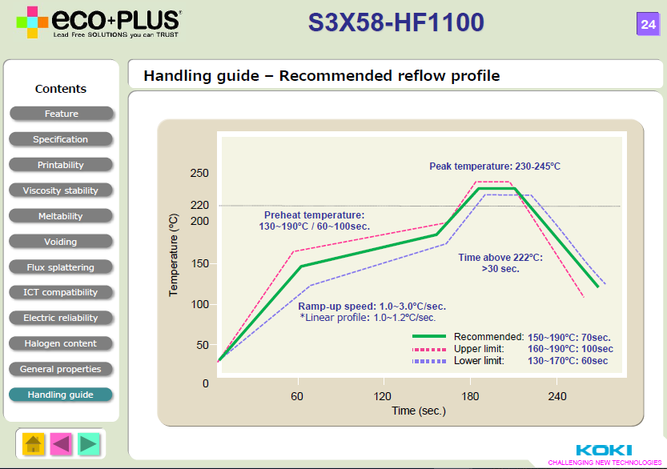
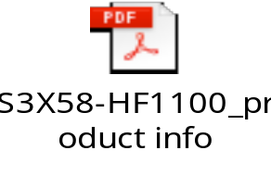
96.1516T00- MIC SMT Solder and Stencil change Controlrun Report
III. Profile data record:
FXC to consult Reflow profile Solder KOKI vendor ’suggestion
COMPARING FXC REFLOW PROFILE Vs S3X58-HF1100 KOKI SOLDER SUGGESTION
Item | Profile feature | KOKI suggest | U6_4/MIC3 | U6_5/MIC4
1 | Ramp-up rate (Tsmax to Tp) | 3°C/second max | 1.60 | 1.59
2 | Preheat Time (130-190°C) (ts) | 60-100 seconds | 72 | 72
3 | Soldering time(TL>222°C) (tL) | >30 seconds | 75 | 75
4 | Peak Temperature (Tp) | Follow Vender’s suggestion 245-250°C | 245.0 | 245.1
Follow supplier of vendor provide item
Summary: FXC to consult Reflow profile Solder Vender ’suggestion.

Slide 5
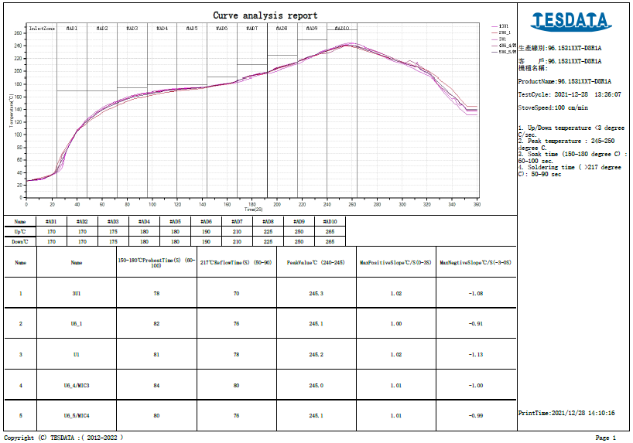
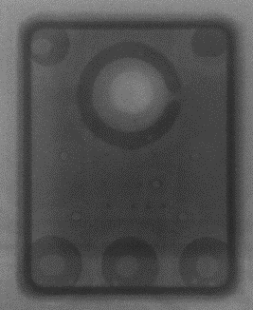
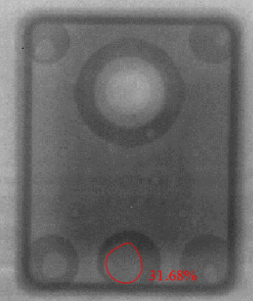
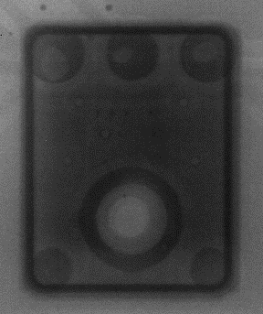
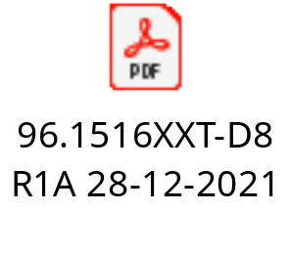
96.1516T00- MIC SMT Solder and Stencil change Control run Report
III. Profile data record:
Reflow profile as attached file, use Profile as FXC optimize and vendor ’suggestion
Scan X-RAY 400pcs: Some MIC parts were defect:
+ Solder ball: 9/400 (2.25%)
+ Void solder: 7/400 (1.75%)
+ O-ring not seal: 11/400 (2.75%)
Summary: Void solder maximum<35%. Have 7 pcs Void solder on 30%-35%.
O-ring not seal: When change Solder Type and Stencil design MIC defect more than normal.
All defects ( O-Ring not seal) to test result pass at RC station.

Slide 6
96.1516T00- MIC SMT Solder and Stencil change Control run Report
IV. Compare between other run Line:
NPI Products
ALT Suggest
Fii Optimate
Used new solder
Status | NPI stage (100pcs) |  |  | Customer's request Profile (50pcs) |  |  | FXC optimize profile (50pcs) |  |  | Control run change Solder Type and Stencil design (400pcs)
 | Fail Q'Ty | Total | Defect rate | Fail Q'Ty | Total | Defect rate | Fail Q'Ty | Total | Defect rate | Fail Q'Ty | Total | Defect rate
Void solder >30% | 11 | 400 | 2.75% | 5 | 200 | 2.50% | 3 | 200 | 1.50% | 7 | 400 | 1.75%
Solder ball | 17 | 400 | 4.25% | 5 | 200 | 2.50% | 5 | 200 | 2.50% | 9 | 400 | 2.25%
O-ring not seal | 0 | 400 | 0.00% | 4 | 200 | 2.00% | 0 | 200 | 0.00% | 11 | 400 | 2.75%
Summary:
- The solder is also more less and it is not improved completely → We’re keep monitoring.
- Void solder is also more less. The maximum void solder is 31.68%.
O-ring not seal is also more less. Checking Test function do not cover this issue
→ Please RD recheck this issue → With New Solder type ME suggestion do not apply online.

